Slide 1
Data Science for Manufacturing
I4 in manufacturing
Can AI ethics
be embedded
into the
innovation lifecycle?
Data Science for Manufacturing Week 6
‘In conversation with…’
Dr Kendra Briken & Prof Dora Scholarios
Strathclyde Business School
Dept of Work, Employment and Organisation

Slide 2
Why we are talking about AI ethics: AI became more potent
Moore’s Law was originally derived from an observation by Gordon Moore, the co-founder of Fairchild Semiconductor and later the co-founder and CEO of Intel.
number of components in a dense integrated circuit (i.e., transistors, resistors, diodes, or capacitors) would be doubling occurring every two years – and so would computational capacity

Slide 3
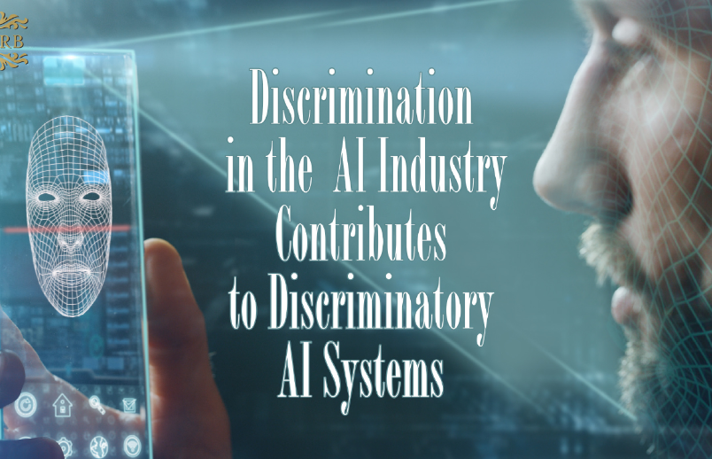
Why we are talking about AI ethics: AI became more autonomous
AI Now Institute (2019)
Discriminating Systems: Gender, Race and Power

Slide 4
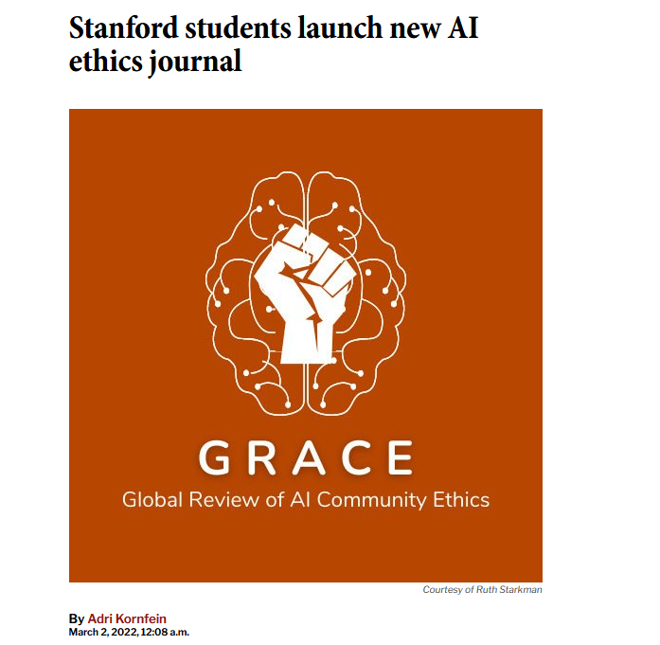
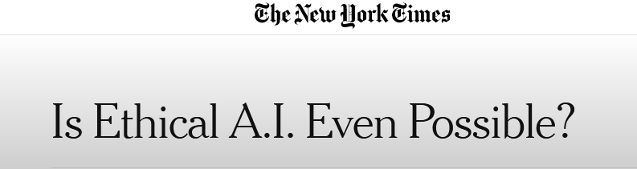

https://www.nytimes.com/2019/03/01/business/ethics-artificial-intelligence.html

Slide 5
Why are we talking about AI ethics?
Equality Act from 2006 defines protected characteristics
age
disability
gender reassignment
marriage and civil partnership
pregnancy and maternity
race
religion or belief
sex
sexual orientation

Slide 6
Regulation as solution? A route to regulation that reflects the ambition of the UK AI Strategy
‘By virtue of their ability to develop and operate independently of human control, and to make decisions with moral and legal consequences, AI systems present a uniform set of general regulatory and legal challenges concerning agency, causation, accountability and control.
At the same time, the specific regulatory questions posed by AI systems vary considerably across the different domains and industries in which they might be deployed.’
(https://www.adalovelaceinstitute.org/report/regulate-innovate/)

Slide 7
Change to Innovate: Towards AI mindsets – and AI ethics cultures?
Digital Manufacturing/Industry 4.0 is the introduction of technology & management practices with a shift in mindset. This shift in mindset can be difficult to achieve and the failure to do it correctly can have a huge cost to the individual business and the national economy.
Positively manufacturing businesses, recognise this with 75% of Leaders anticipate a level of staff resistance, or apprehension, in relation to the changes that I4.0 adoption may bring. (…)
SMAS Industry 4.0 Review findings (https://www.scottish-enterprise.com/support-for-businesses/develop-products-and-services/support-for-manufacturers)

Slide 8
How to regulate ‘second order’ issues, such as decent and fair work?
It is important to understand the potential human and social impacts of AI algorithm-enabled decision making and automation on manufacturing workplaces and the impact on workers’ voice, the decline of human connection to AI-based decision making, and power and surveillance at work (Moore et al 2018, Zuboff 2019). Trade Unions collectively pledge for dignity at work (TUC 2021).
Research focussing on I4 more specifically suggests that AI-driven systems are particularly impactful on autonomy and discretion. Butollo et al.’s (2018) extensive study in German I4 manufacturing concludes that there is little to no integration of machine and data-based analysis with human competence development and work experience in the design of high-performance management systems.
They conclude that although algorithmic control might relieve employees from stressful decision making and improve health and wellbeing, these benefits could also be outweighed by the loss in voice and intrinsic task motivation. Alongside potential benefits, employees lose control over how much of their tacit knowledge, previously embodied in their job-related knowledge and experience and mostly invisible to their employer, necessarily is now recorded and used for decision making. AI-enabled technologies applied to work, thus, extract new (bodily) knowledge, shift the nature of how skills are developed and used, and introduce new forms of management control which extract situated knowledge owned by the worker, which is often crucial for resistance and collective struggle (Briken 2020).

Slide 9
What is Ethics about?
Ethics is a ‘Should’ be approach: A branch of philosophy concerned with ways of thinking about morality, and moral judgment.
Ethics frames the good the bad – and the ugly: asks basic questions about the good life, about what is better and worse, about whether there is any objective right and wrong, and about how we know it, if there is.
Ethics impacts on Morality – Human conduct and character referring to “those acts which it makes sense to describe as right or wrong, good or bad.”

Slide 10
Core areas of concern
Honesty, openness, responsiveness, accountability, due diligence, and fairness are core ethical principles.
There is no general or global consensus for defining ethical behaviour for individuals, as it may change from time to time and from one place to another place.
There is no universal measure or standard as to what constitutes ethical behaviour.

Slide 11

Utilitarism won’t save us…

Slide 12
Strands of ethics
Descriptive ethics: What do people think is right?
Meta-ethics: What does "right" even mean?
Normative (prescriptive) ethics: How should people act?
-- > Applied ethics: How do we take moral knowledge and put it into practice?

Slide 13



The idea:
Bridging AI ethics, responsible innovation, and human labour issues
Observation 1: Digital Transformation in Manufacturing led to discussions and frameworks on AI ethics (i.e. Aletheia, Rolls Royce)
Observation 2: Employees seem to resist, or are opposed to digital change – are their concerns related/relatable to ethical issues?
Question 1 : How do different stakeholders in the innovation lifecycle perceive ethical issues? What are the underlying idea that drive engineering and data sciences?

Slide 14
Core Issue: AI ethics as Process
Dimension 1: Perspectives across the Innovation Lifecycle
Dimension 2: Perspectives throughout the stack
How do AI ethical frameworks impact on innovation and workplaces in Industry 4.0?
When are ethical concerns considered? During conception, prototyping, deployment?
When should AI ethical concerns be considered?
Industry 4 innovation brings together expertise from multiple partners throughout the stack - users, coders, service providers, libraries, compilers and hardware
How do ethical considerations vary amongst partners, disciplines and professional background?
Do AI ethical frameworks impact differently throughout the stack?

Slide 15
Towards Industry Best Practice? Aletheia Framwork, Rolls Royce
Developed by Rolls Royce, first version published in 2020,
Open Source Tool for AI ethics checks available since December 2021.
Three main areas covered
Accuracy & Trust
Governance
Social Impact (second order?)

Slide 16
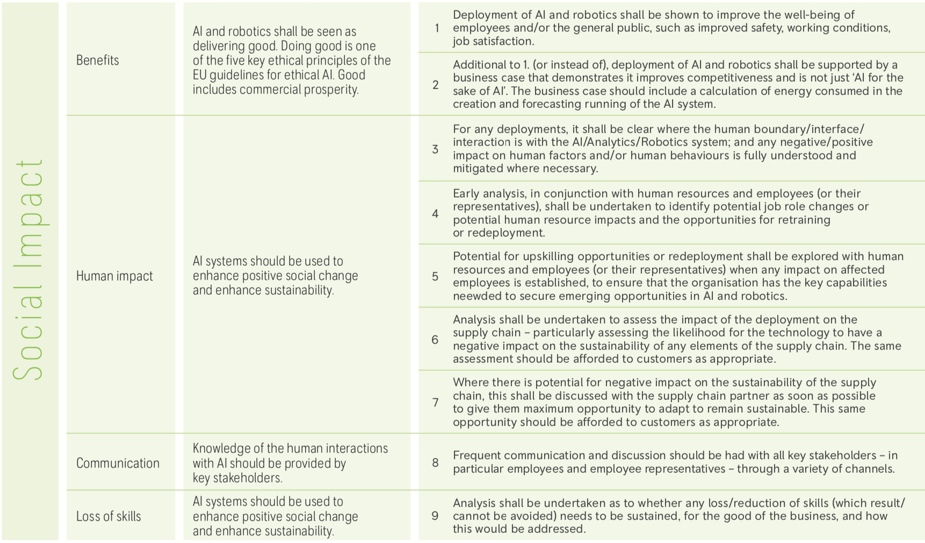

Slide 17
No such thing as perfect solution to AI ethics
‘The Aletheia Framework hasn’t solved all its challenges, it can help reassure organisations, people and communities that the ethical implications of an AI have been fully considered; it is as fair as possible; and makes trustworthy decisions.’
https://www.rolls-royce.com/sustainability/ethics-and-compliance/the-aletheia-framework.aspx

Slide 18





The Research Team -
Bridging disciplines: Engineering, Law, Sociology, Psychology
Dr Kendra Briken
Strathclyde Business School
Dept of Work, Employment & Organisation (Sociology)
Dr Emily Rose
Law School
University of Strathclyde
Prof Dora Scholarios
Strathclyde Business School
Dept of Work, Employment & Organisation (Psychology)
Prof Andrew Sherlock
Director of Data-driven Manufacturing,
National Manufacturing Institute Scotland
Dr Jed Moore
Strathclyde Business School
Dept of Work, Employment & Organisation (Sociology & Engineering)

Slide 19
Programme of interviews with relevant partner employees during Q1&2 2022
Community of Interest formed for discussion of AI ethics and its impacts on the workplace
Discussions with partners about a methodology for a future, larger scale, project to gather in-depth data of AI ethics in action
Dissemination of findings via reports and events
Industrial Partners

Slide 20







Potential Partners
If you are interested in participating contact
kendra.briken@strath.ac.uk

